Slide 1
IBM University Engagement Project Submission
“Exploring the Power of Agentic AI with IBM Granite and Orchestrate”

Slide 2

Project Title – Travel Planner Agent – AI-Powered Personalized Travel Assistant
Domain of the Project – Travel & Tourism
Student Name | Recent Passport Photo | Email ID | Mobile number [WhatsApp]
CHIPPA RUPASRI |  | chipparupasri@gmail.com | 7981638939

Slide 3
Problem Statement -
Problem Statement : Travel Planner Agent – AI-Powered Personalized Travel Assistant
The Challenge :
Planning a trip can be stressful and time-consuming. Travelers often need to search multiple websites for destinations, accommodations, transportation, weather conditions, and local attractions. This scattered information makes travel planning inefficient and overwhelming.
The Objective :
Build an AI-powered Travel Planner Agent that helps users plan trips efficiently and intelligently.
The solution should:
Recommend destinations based on user preferences.
Generate personalized travel itineraries.
Suggest hotels and accommodations.
Recommend transportation options.
Provide budget-friendly travel plans.
Offer travel tips and attraction recommendations.
Deliver a seamless travel planning experience.

Slide 4
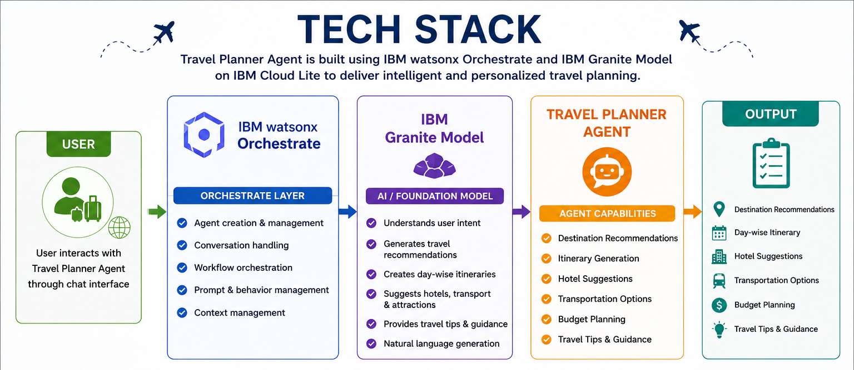
Technology Used :
I used IBM Watsonx Orchestrate + IBM Granite Model
🤖 IBM watsonx Orchestrate :
Used to create and manage the Travel Planner Agent.
Handles user interactions and travel planning workflows.
Coordinates different travel-planning tasks in a single
conversational interface.
Enables Agentic AI capabilities through intelligent
decision-making.
🧠 IBM Granite Foundation Model :
Powers the intelligence behind the Travel Planner Agent.
Understands user travel requirements and preferences.
Generates personalized travel recommendations.
Creates day-wise itineraries and travel suggestions.
💬 Prompt Engineering :
Custom instructions were designed to guide the agent's behavior.

Slide 5
Proposed Solution -
Proposed Solution: AI-Powered Travel Planner Agent
The proposed solution is an AI-powered Travel Planner Agent built using IBM watsonx Orchestrate and IBM Granite Models. The system helps users create personalized travel plans based on their budget, travel dates, interests, and destination preferences.
The Travel Planner Agent interacts with users through a conversational interface and gathers travel requirements such as source location, destination, budget, duration, and interests.
Using IBM Granite Models, the agent analyzes user preferences and generates:
Personalized destination recommendations
Day-wise travel itineraries
Hotel and accommodation suggestions
Transportation recommendations
Budget-aware travel plans
Travel tips and attraction suggestions
The solution simplifies travel planning by providing all required information in a single intelligent assistant.
Features :
✅ Personalized Trip Planning ✅ Day-Wise Itinerary Generation
✅ Budget-Based Recommendation ✅ Hotel Recommendations

Slide 6
IBM Watsonx Orchestrate Components Used :
Agent :
Travel Planner Agent
Main AI agent created in Watsonx Orchestrate. And Handles user interactions and travel planning requests.
2) Welcome Message :
Greets users and introduces the Travel Planner Agent. Provides an engaging starting experience.
3) Quick Start Prompts :
Predefined travel planning queries. Helps users quickly explore the agent's capabilities.
Examples:
Plan a 3-day trip to Goa under ₹15,000.
Suggest the best destinations for a family vacation in India.
4) Behavior Instructions :
Defines how the agent should respond.
Guides itinerary generation, destination recommendations, hotel suggestions, and travel tips.
5) Foundation Model (IBM Granite):
Powers natural language understanding.
Generates personalized travel plans and itineraries.

Slide 7
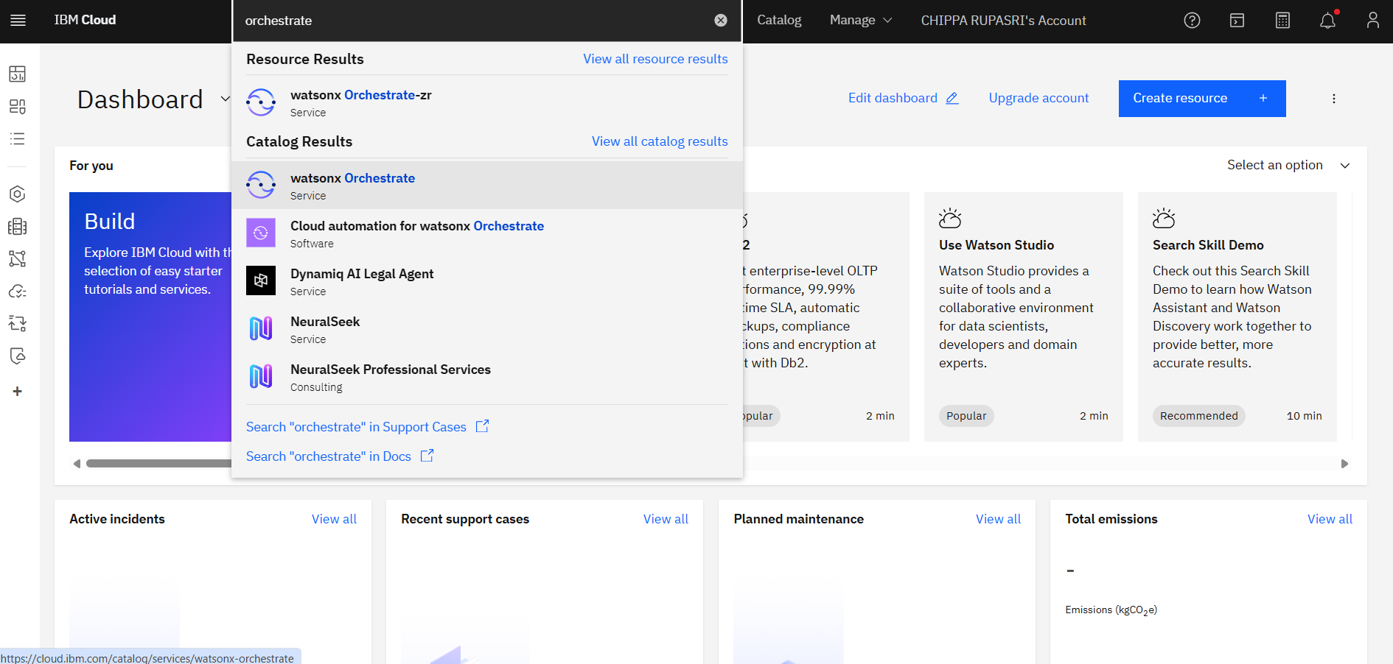
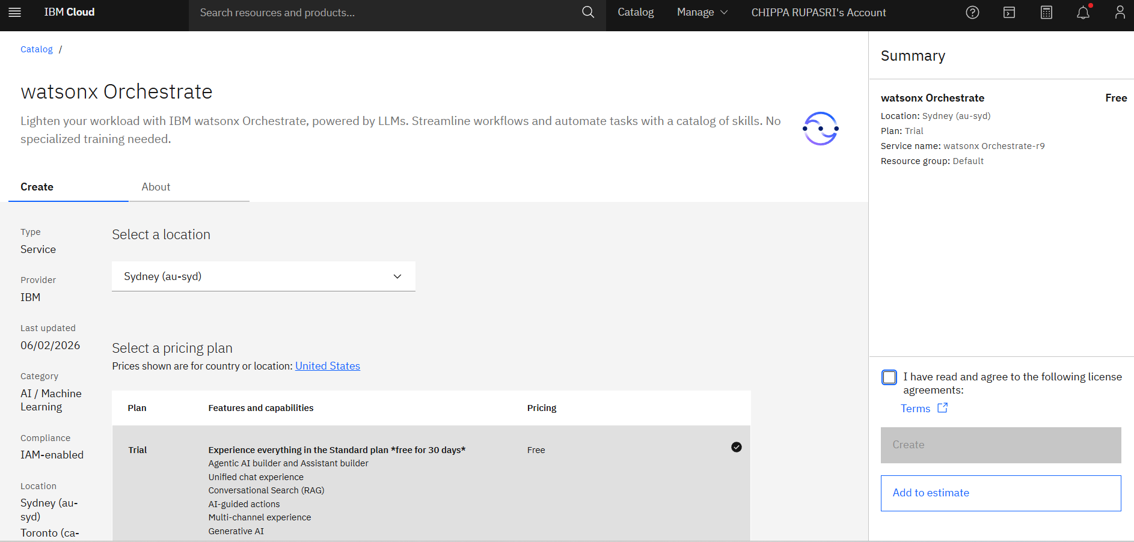
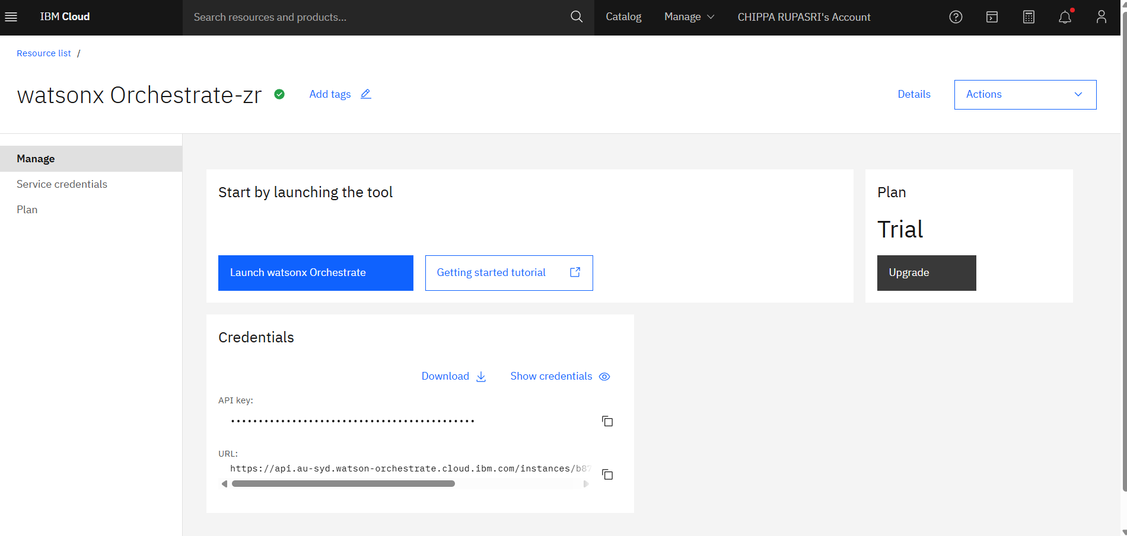
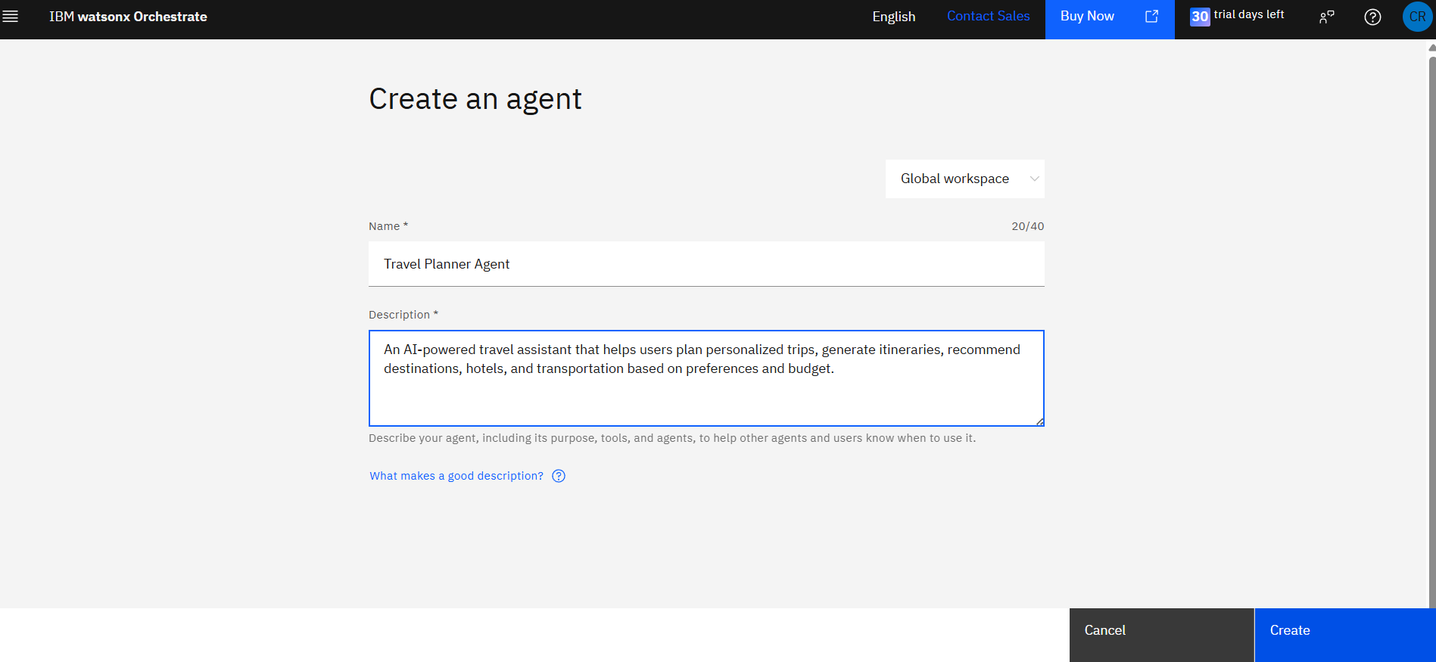
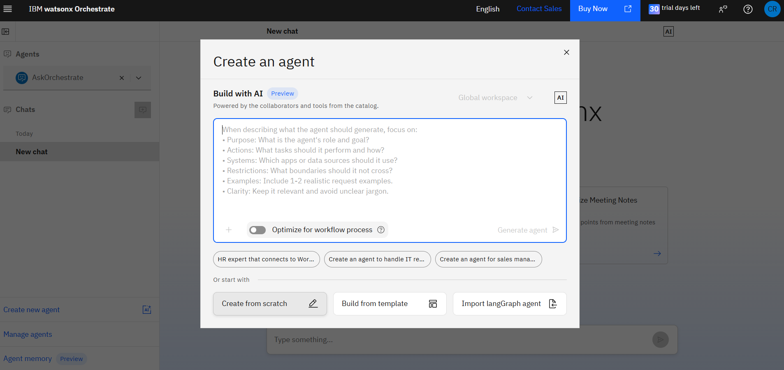
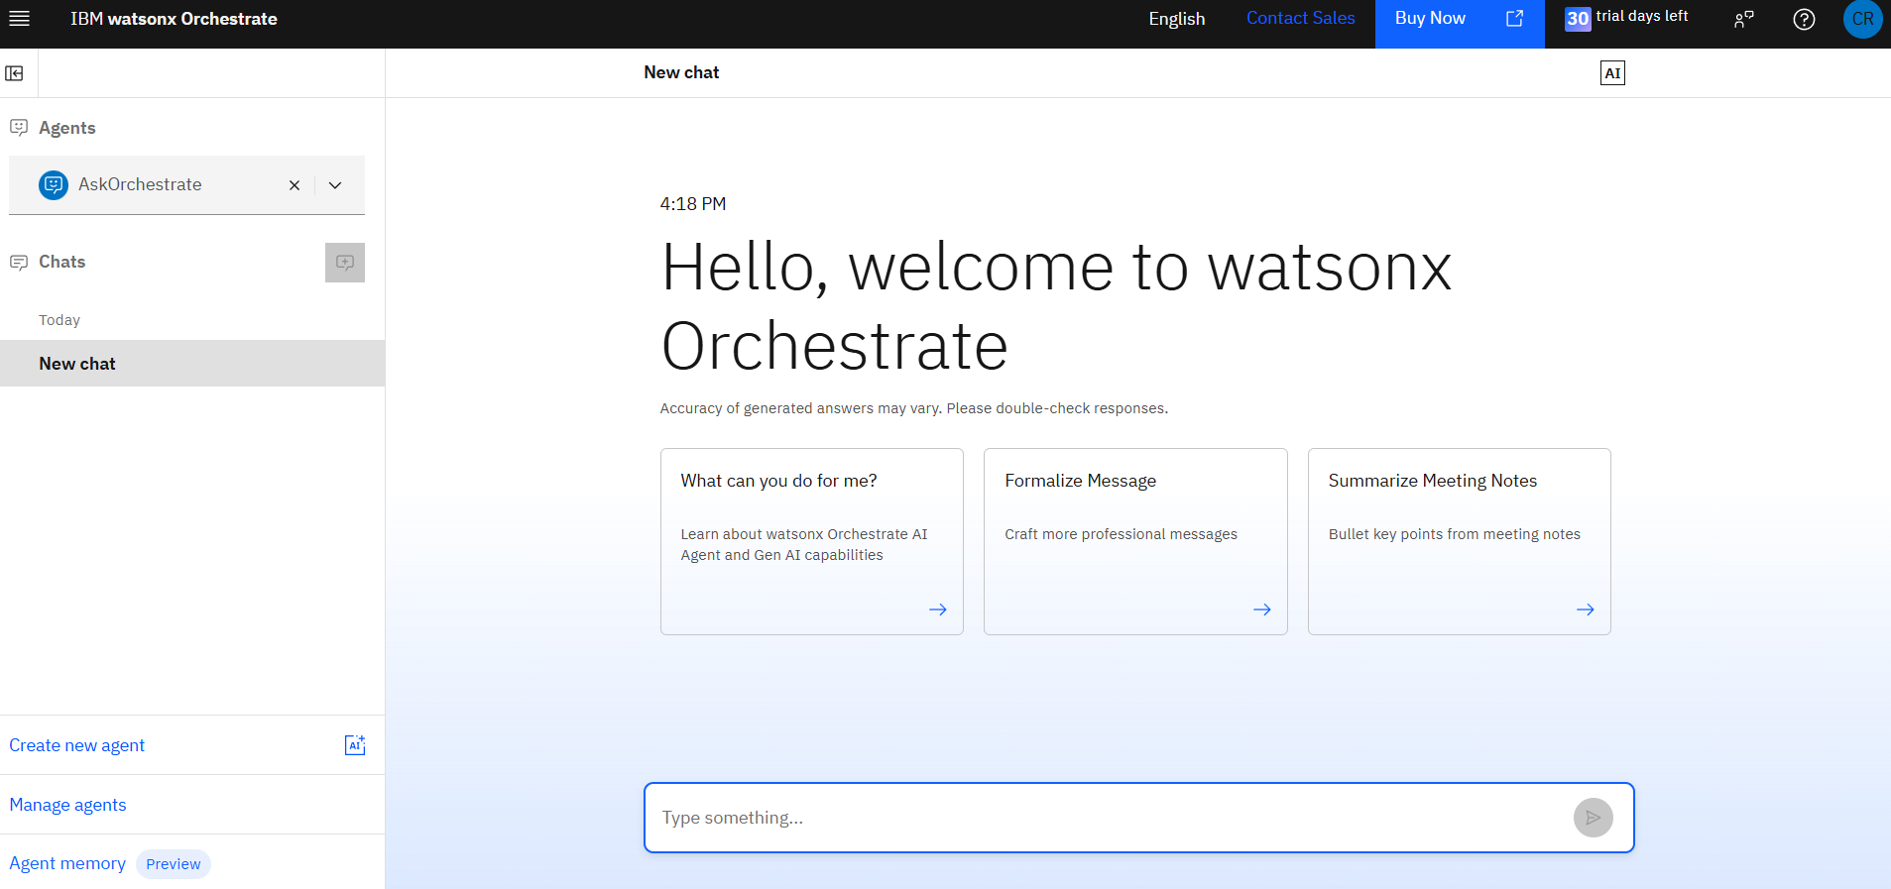
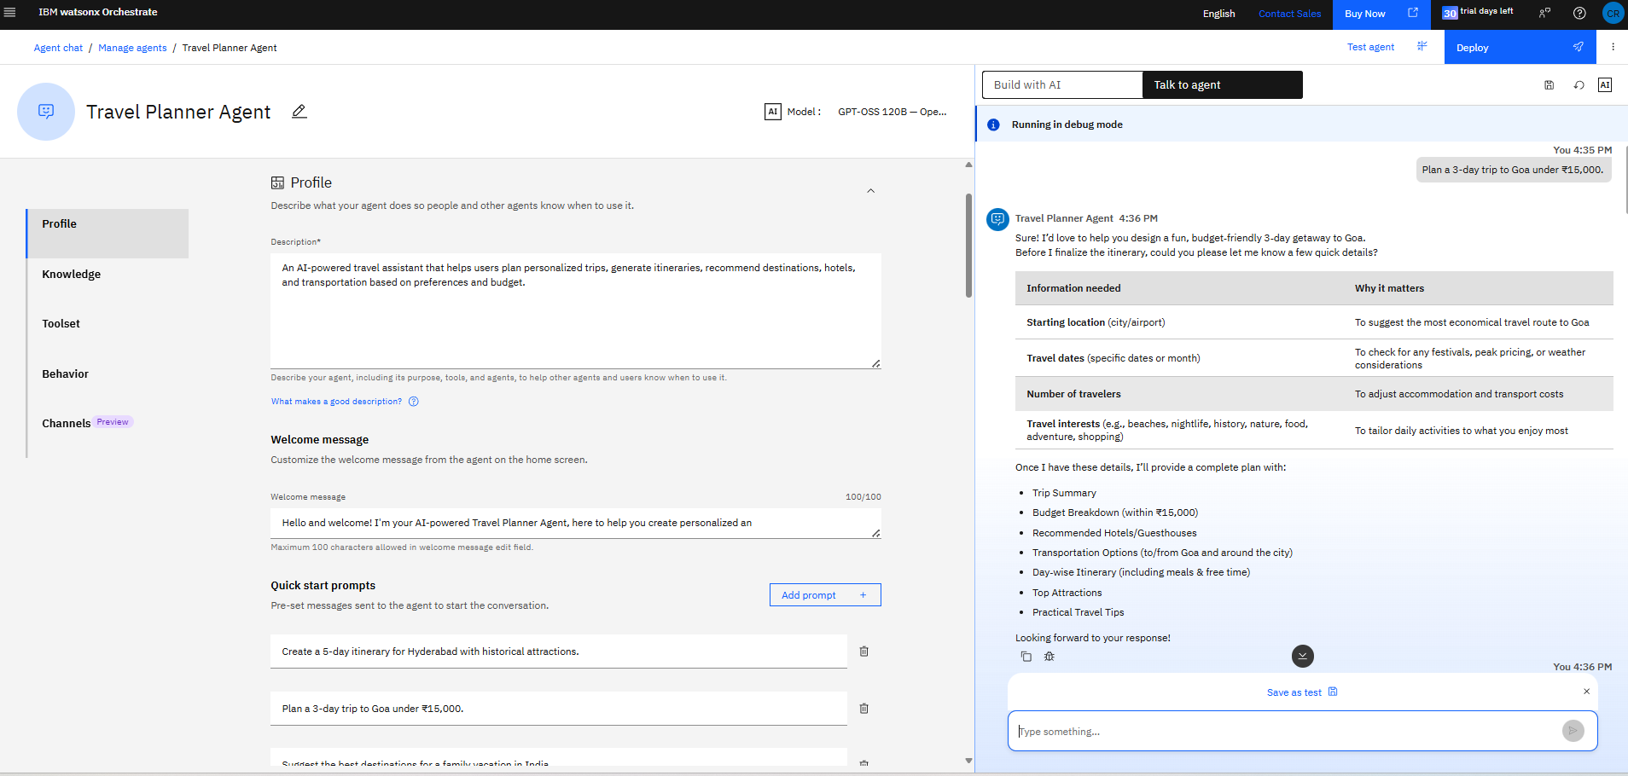
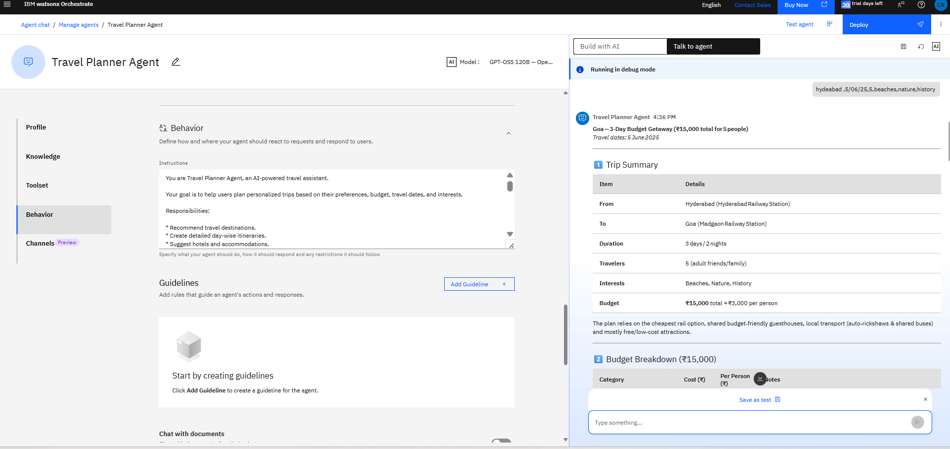
Orchestrate workflow -

Slide 8
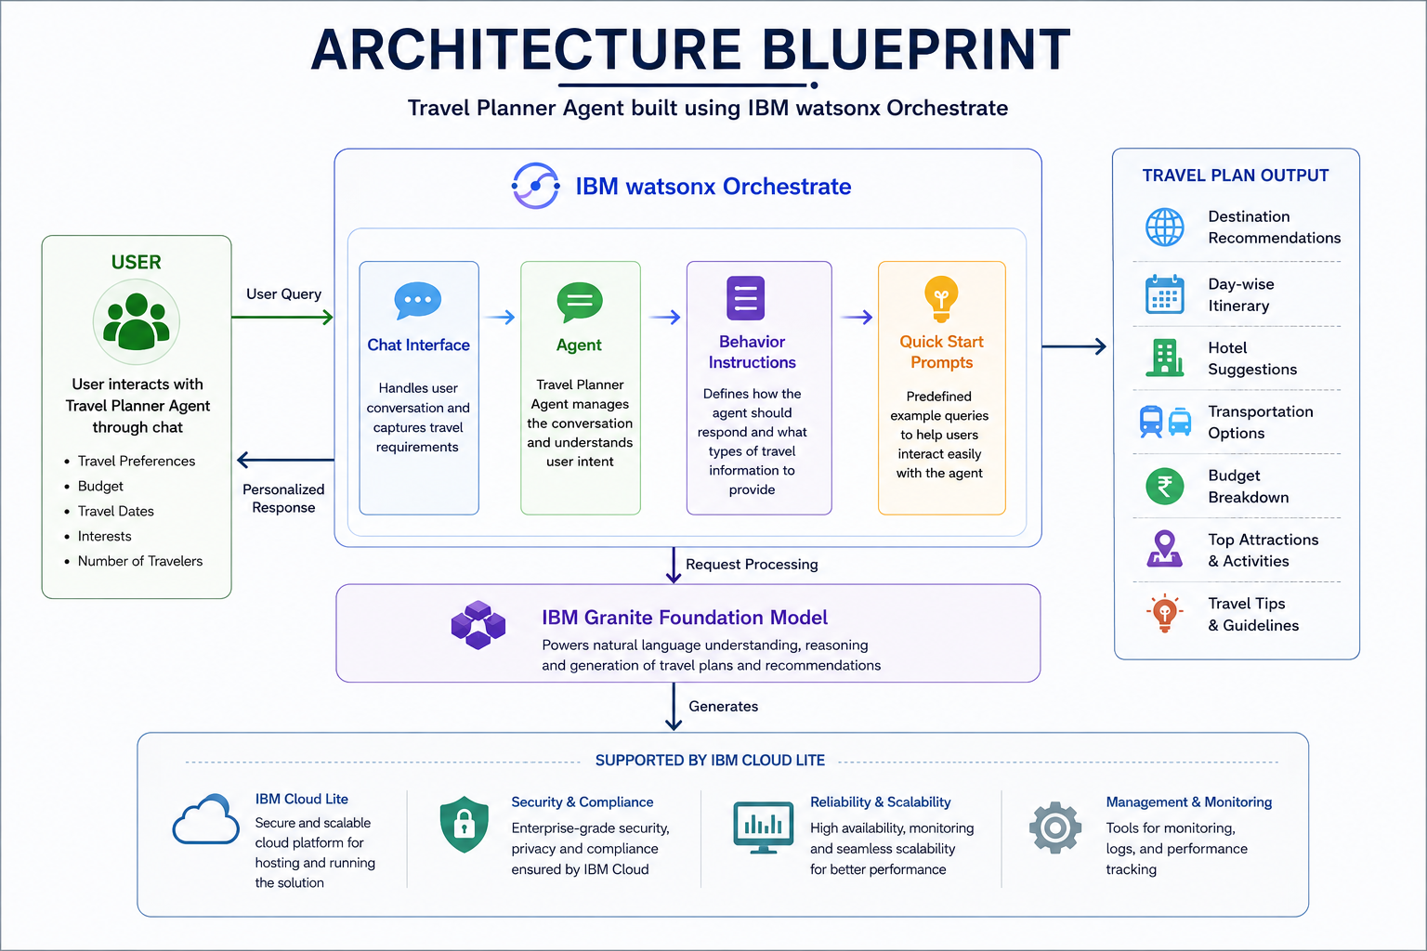
Architecture blueprint :

Slide 9
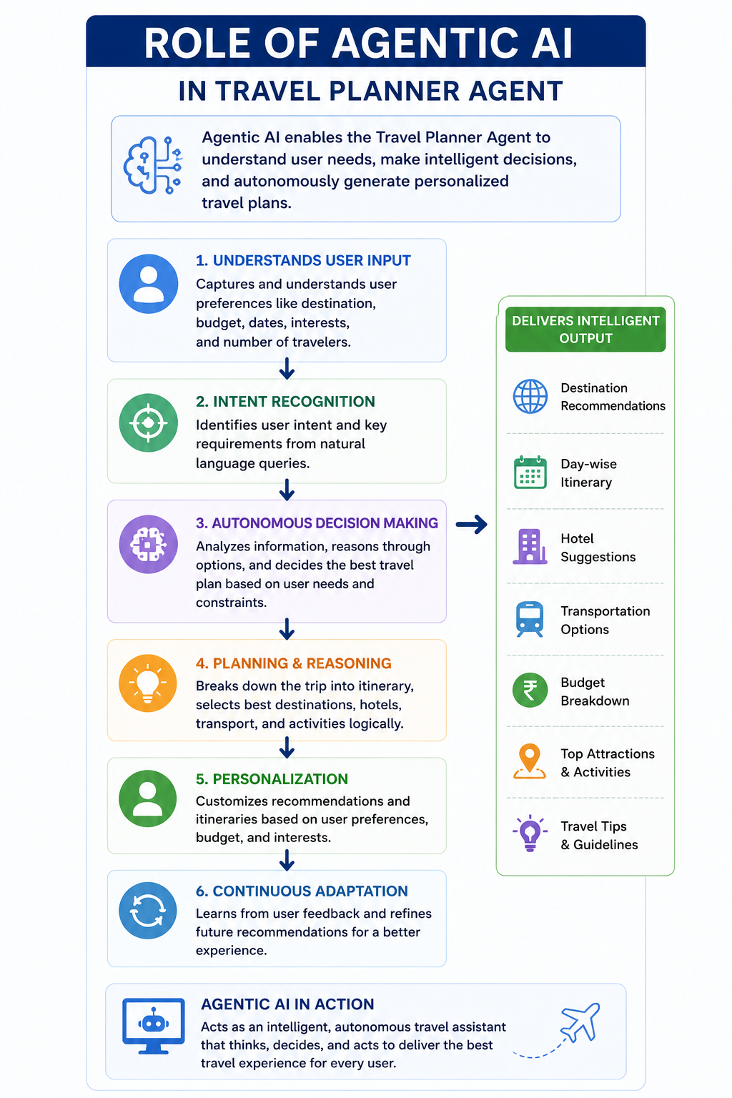
Role of Agentic AI in the solution :
Role of Agentic AI in Travel Planner Agent :
Agentic AI enables the Travel Planner Agent to function as an intelligent and autonomous travel assistant.
The system understands user preferences, travel goals, budgets, and interests, then independently generates personalized travel recommendations and itineraries.
Agentic AI allows the agent to:
Analyze travel requirements
Make destination recommendations
Create customized itineraries
Suggest accommodations and transportation
Provide travel guidance
By continuously adapting recommendations based on user input, the Travel Planner Agent delivers a personalized and goal-oriented travel planning experience.

Slide 10
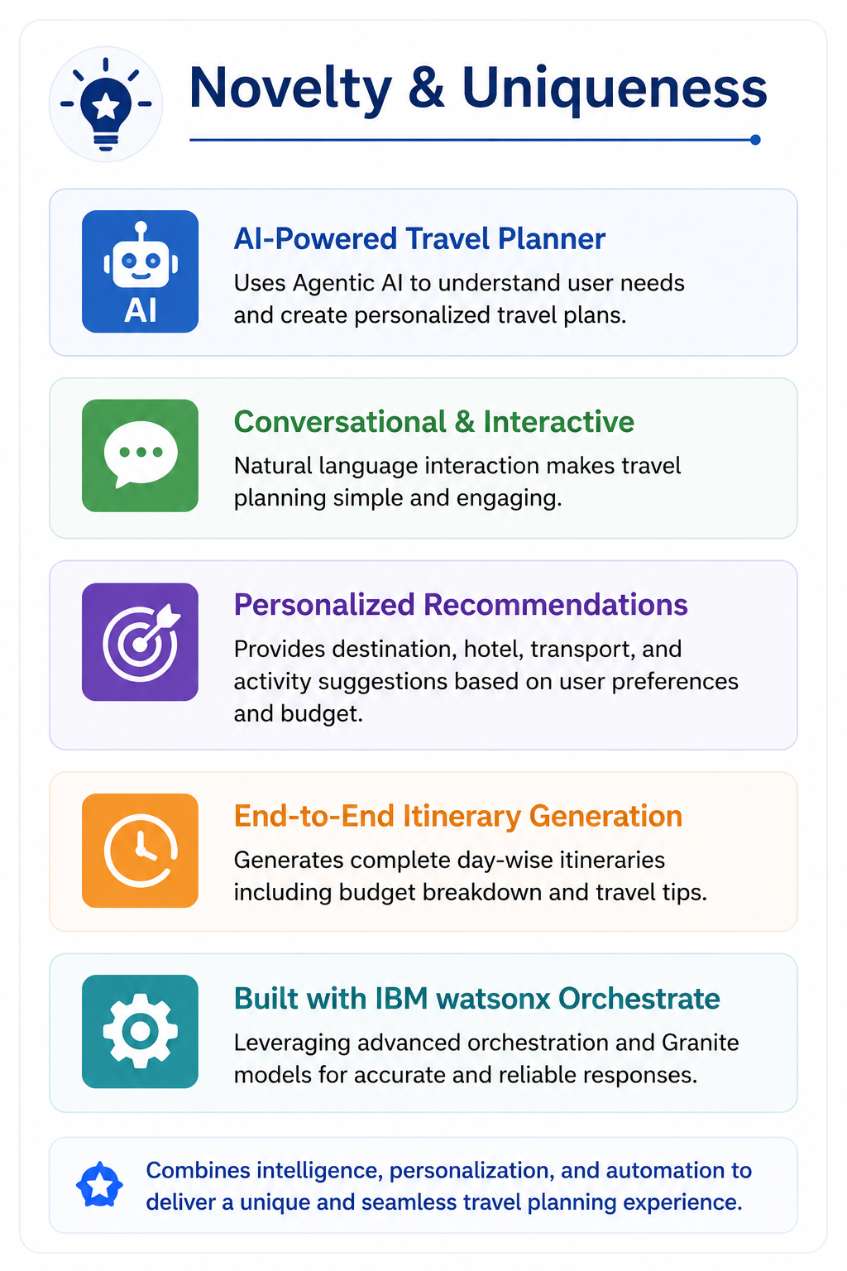
Novelty and Uniqueness :
Personalized Travel Planning
Generates customized travel plans based on user preferences.
AI-Powered Itinerary Generation
Automatically creates detailed day-wise schedules.
Budget Optimization
Suggests travel options within user budgets.
Intelligent Recommendations
Provides destination, accommodation, and transportation suggestions.
Conversational User Experience
Allows users to interact naturally with the travel assistant.
IBM Agentic AI Integration
Combines IBM watsonx Orchestrate and Granite Models for intelligent
travel planning.

Slide 11
Git Hub Link :
Repository Name: Travel-Planner-Agent
GitHub URL:
https://github.com/Chipparupasri123/Travel-Planner-Agent
🎥 Demo Video: https://drive.google.com/file/d/11ehowYHljfvEcRa2AtZn1afLlGlZGOw1/view?usp=sharing
Repository Contents:
1)README.md
2)Travel Planner Agent.pdf
3)Travel Planner Agent Presentation.pptx
4)Screenshots Folder
·
·
·

Slide 12
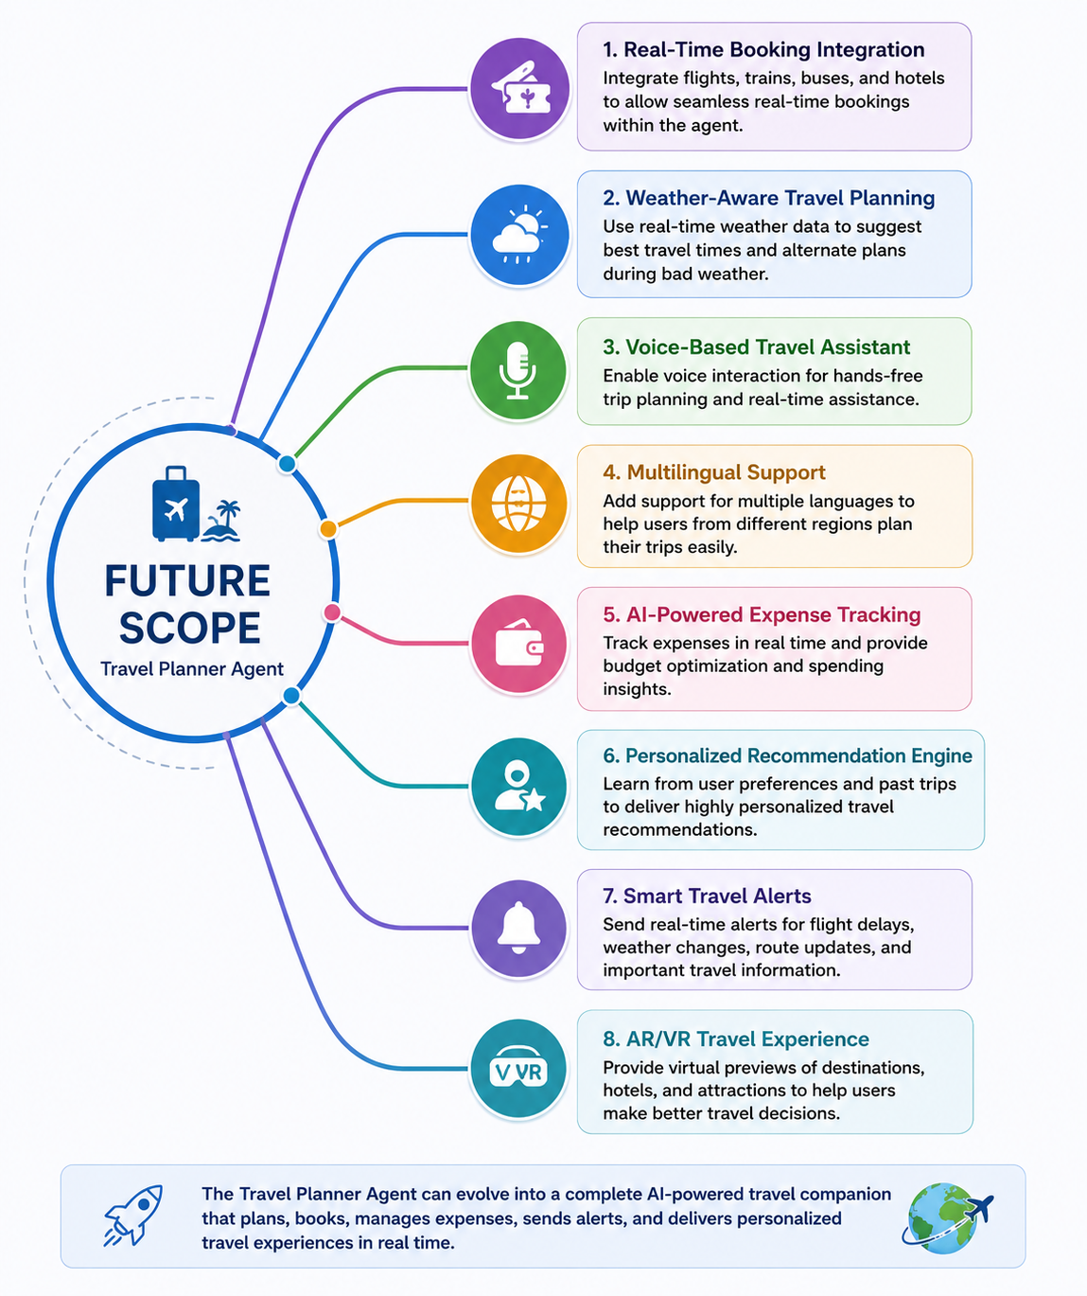
Future Scope :
1. Real-Time Booking Integration
Integrate flight, train, bus, and hotel booking platforms.
Allow users to make reservations directly through the Travel Planner Agent.
2. Weather-Aware Travel Planning
Connect with weather APIs to provide live weather forecasts.
Automatically suggest itinerary changes during adverse weather conditions.
3. Voice-Based Travel Assistant
Enable users to interact using voice commands.
Improve accessibility and user convenience.
4. Multilingual Support
Support multiple regional and international languages.
Help users from diverse backgrounds plan trips easily.
5. AI-Powered Expense Tracking
Track travel expenses in real time.
Provide budget optimization and spending insights.
·
·
·

Slide 13


